Slide 1
Walmart Stock Analysis
Guide : Venkat Sir
DE Expert
- Gaurav Bhadane Data Engineer

Slide 2











Architecture of the solution
SOURCE
DATA INGESTION
DATA ANALYSIS
VISUALIZATION
Local File System
Pipeline 5
Pipeline 1
Sqoop
RDBMS
Pipeline 2
Pipeline 3
Pipeline 6
Pipeline 4

Slide 3
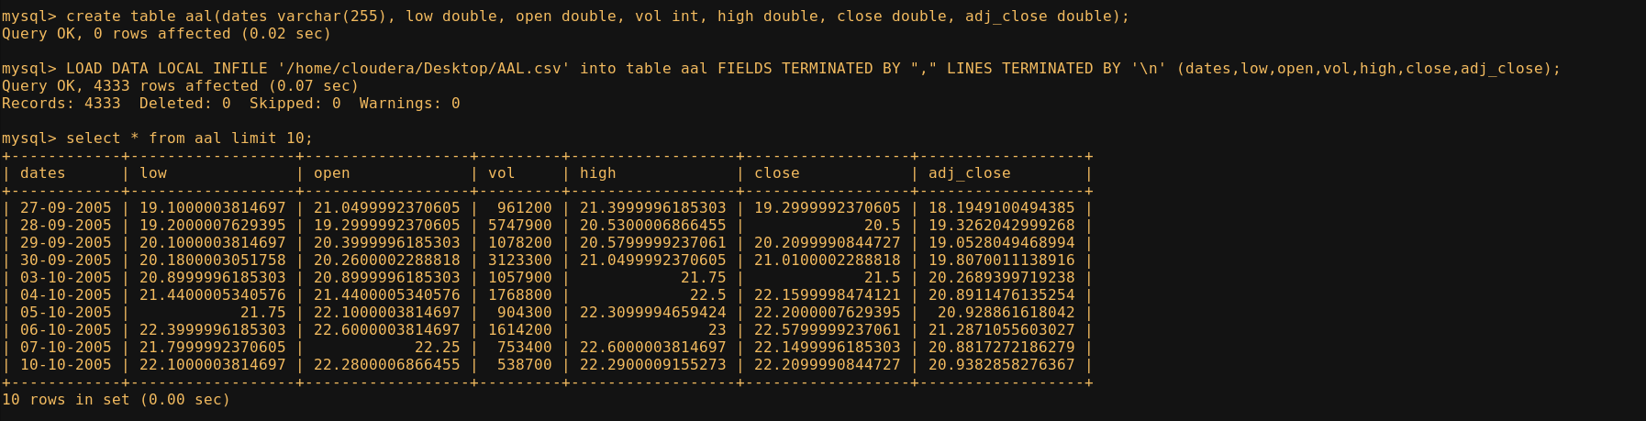
The Dataset
Available Tables and no .of records
Date: Stock trading dates
Open: Opening price of a stock in the beginning of the day.
Close: Closing price of a stock at the end of the day.
High: Highest price at which a stock is traded during the day.
Low: Lowest price at which a stock is traded during the day
Volume: Total no .of shares of a stock traded during the day.
Adjusted Close: The stock price after considering dividends paid to shareholders.
AAL
Total Records : 4333
ABIO
Total Records : 6379
AAOI
Total Records : 2320
ABMD
Total Records : 8916
Total Records : 21948

Slide 4
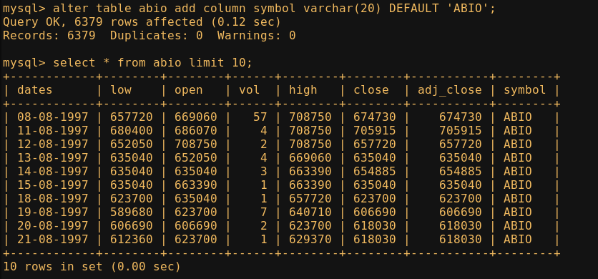
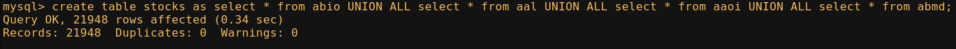
Data Loading
Create 4 tables in MySQL – abio, aal, aaoi, abmd
Move the data in Local File Sytem to each MySQL table using the following command:
LOAD DATA LOCAL INFILE '/home/cloudera/Desktop/ABIO.csv' into table abio FIELDS TERMINATED BY "," LINES TERMINATED BY ‘\n’ (date,low,open,vol,high,close,adj_close);
Add symbol column to the tables using ALTER command
Merge all tables into one – ‘stock’, using UNION ALL command.
1
2
3

Slide 5
Batch Processing using
First we, import the data from MySQL to Hive Data Warehouse using Sqoop import pipeline.
Instead of putting data into HDFS, we put directly into Hive, which saves us from wasting resources and time.
We use the following command in the Cloudera Command-Line:
sqoop import --connect jdbc:mysql://localhost/walmart --username root --password cloudera --table stock --hive-import --hive-table hive_stock -m 1
Here ‘walmart’ is the MySQL database, ‘stock’ is MySQL table and ‘hive_stock’ is Hive Data Warehouse table.

Slide 6
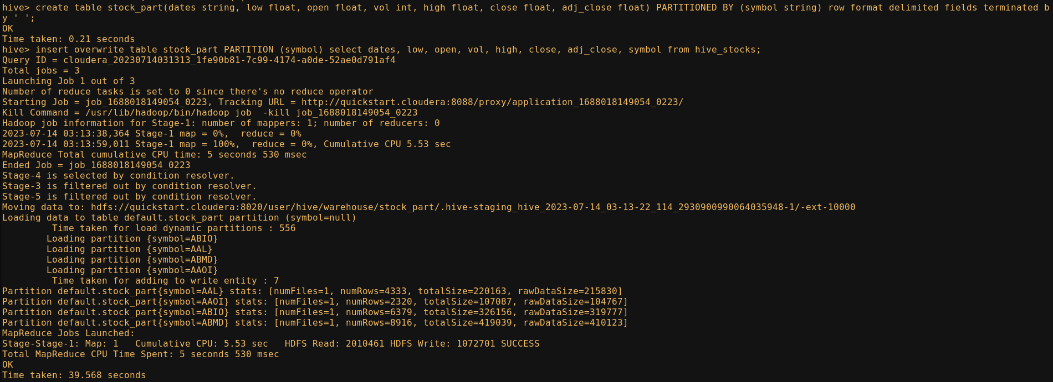
Partitioning the Data
Partitioning is a technique in Hive, which is used for data optimization.
Using the following command the table ‘hive_stocks’ was partitioned and stored as table ‘stock_part’ :
Creating partition
Inserting the Data

Slide 7
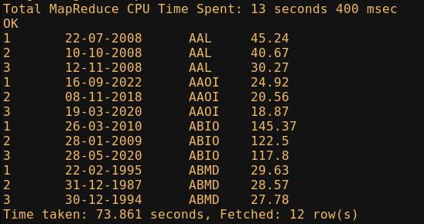
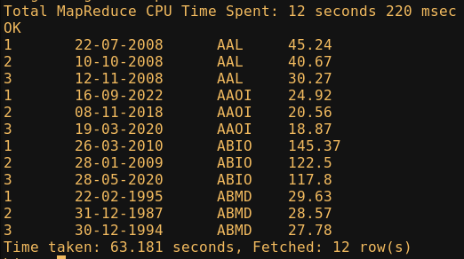
Result of Partitioning
Without Partition
With Partition

Slide 8
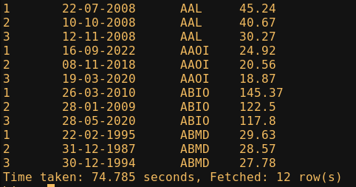
Problem Statement
Question 1: Write a Hive query to identify the top three dates that experienced the largest percentage change in stock price (from open to close) for every stock.
Query : select rn, dates, symbol, percentage_change from (select dates, symbol,percentage_change, row_number() over(partition by symbol order by percentage_change desc) as rn from (select symbol, dates, round(abs(((close - open) / open) * 100), 2) as percentage_change from stock_part)a )b where rn <= 3;

Slide 9
Creating external table
Create an external table using the following command:
create external table hive_1(Row_num int, Date string, Symbol string, Percentage_change float) row format delimited fields terminated by ' ' location '/user/hive/warehouse/hive1';
Now, insert the results achieved after processing the internal table into external table using the following command:
insert overwrite table hive_1 select rn, dates, symbol, percentage_change from (select dates, symbol,percentage_change, row_number() over(partition by symbol order by percentage_change desc) as rn from (select symbol, dates, round(abs(((close - open) / open) * 100), 2) as percentage_change from stock_part)a )b where rn <= 3;

Slide 10
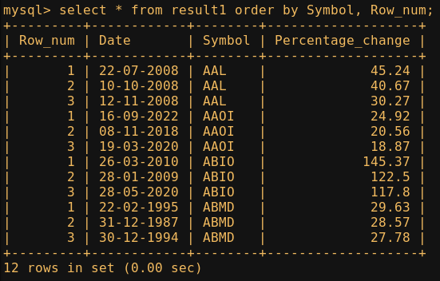
Exporting to MySQL
Create a result table in MySQL:
Create table result1(Row_num int, Date varchar(20), Symbol varchar(5), Percentage_change float);
Exporting the external table into MySQL result table using sqoop:
sqoop export --connect jdbc:mysql://localhost/walmart --username root --password cloudera --table result1 --export-dir /user/hive/warehouse/hive1/000000_0 --input-fields-terminated-by ' '
After exporting to MySQL we can view the data as seen in the screenshot
This output can be saved to Local File System as csv and can be used for visualization.

Slide 11

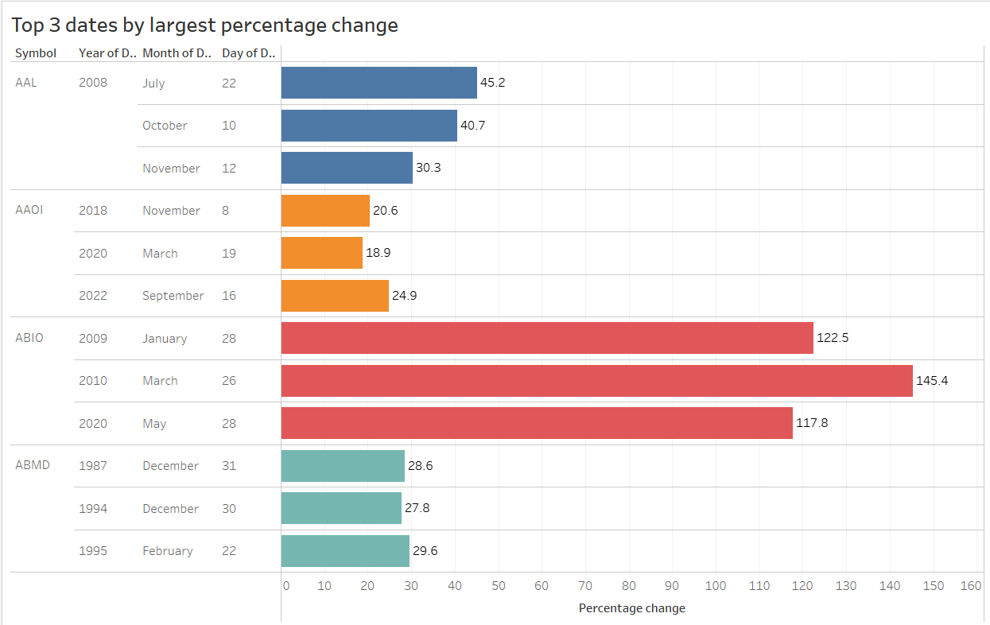
Visualization using
Using the CSV file created by exporting the MySQL output, creating a visualization in Tableau:

Slide 12
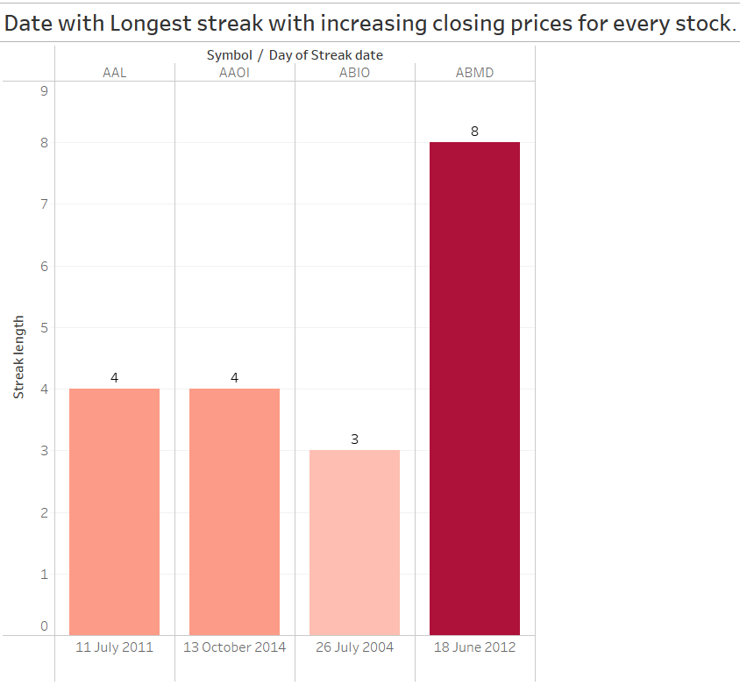
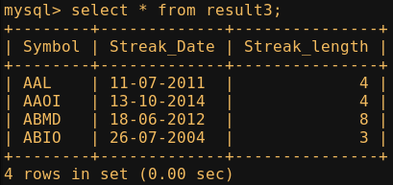
Problem Statement
Question 3: Write a Hive query to find the date with the longest consecutive streak of increasing closing prices for every stock.
Query : select symbol, streak_date, streak_length
from (select symbol, streak_date,streak_length, ROW_NUMBER() OVER (partition by symbol order by streak_length desc) as rn
from (select symbol, dates, close, sum(is_increasing) OVER (partition by symbol, g order by dates) as streak_length, FIRST_VALUE(dates)OVER (partition by symbol, g order by dates) as streak_date
from (select symbol, dates, close,CASE WHEN LAG(close, 1) OVER (partition by symbol order by dates) < close THEN 1 ELSE 0 END as is_increasing, date_sub(dates, ROW_NUMBER() OVER (partition by symbol order by dates)) as g
from stock_part) as sub) as sub2) as sub3 where rn = 1;

Slide 13
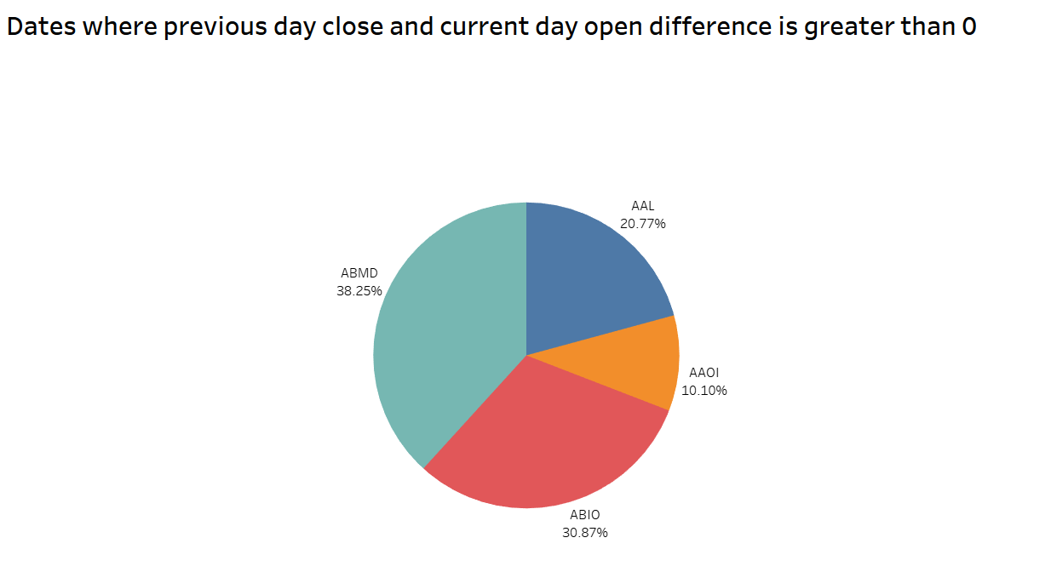
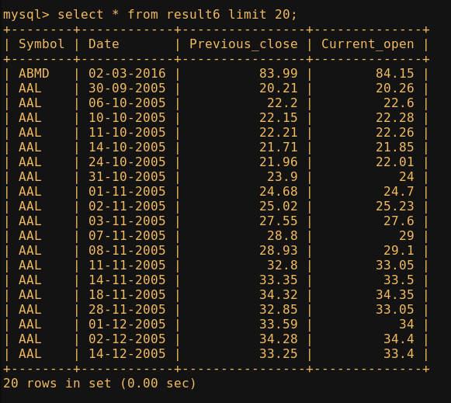
Problem Statement
Question 6: Write a Hive query to find the dates where previous day close and current day open difference is greater than 0 for each stock.
Query : select symbol, dates, round(prev_close, 2) as previuos_close, round(open,2) as current_open from
(select symbol, dates, LAG(close) OVER (Partition by symbol) AS prev_close, open
from stock_part) st where (open - prev_close) > 0
order by CAST(dates as DATE), symbol;

Slide 14

Interactive Processing using
IMPORT LIBRARIES –
import findspark
import pyspark
from pyspark.sql import SparkSession
from pyspark.sql.functions import *
READ DATAFILE
spark = SparkSession.builder.appName(‘aggs').getOrCreate()
df=spark.read.csv("walmart_stock.csv",inferSchema=True,header=True)

Slide 15
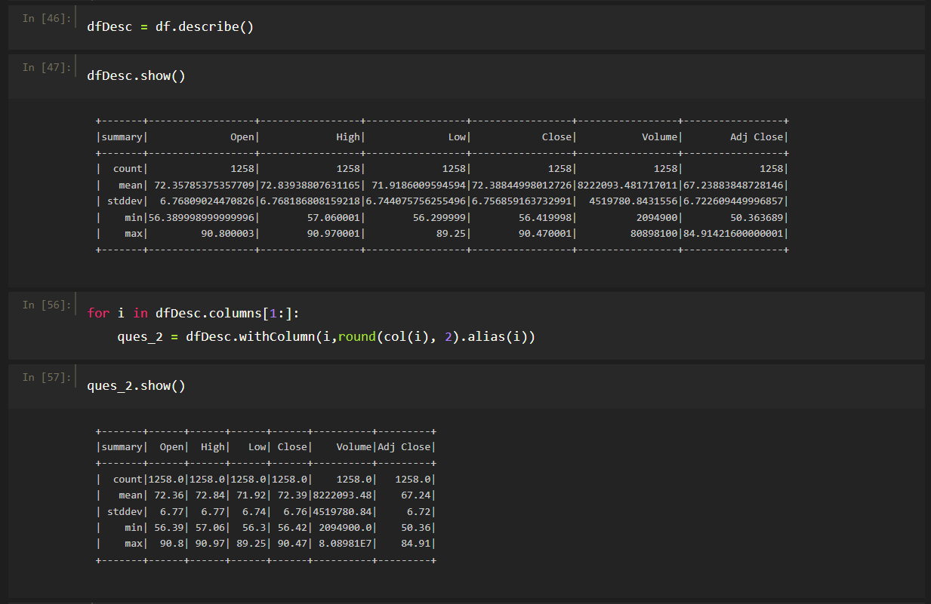
Problem Statement
Question 2: There are too many decimal places for mean and stddev in the describe() dataframe. Format the numbers to just show up to two decimal places.

Slide 16
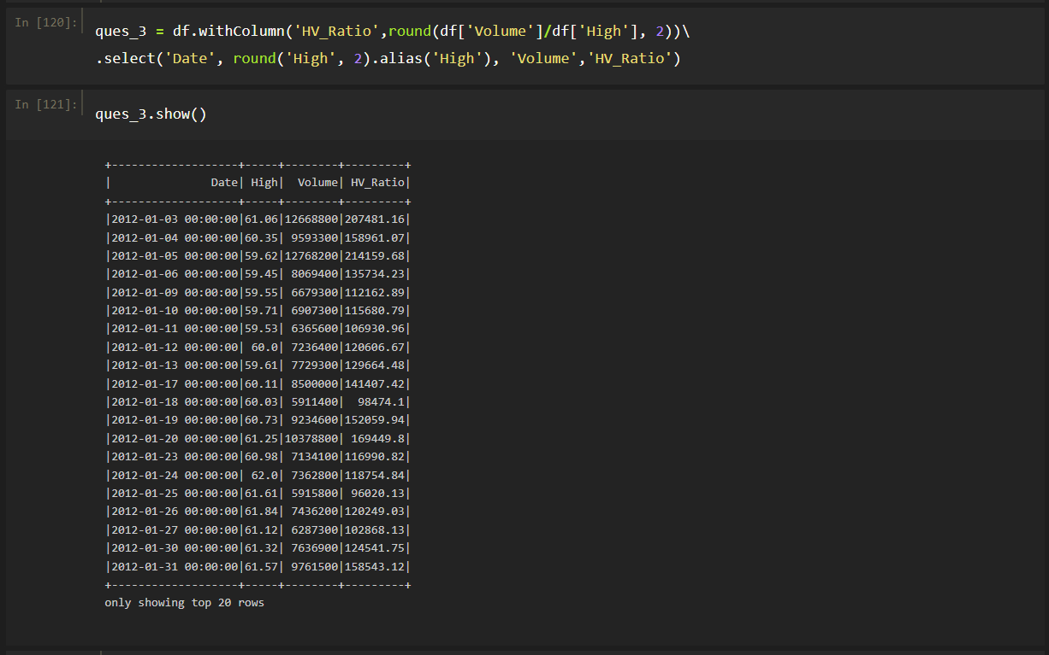
Problem Statement
Question 3: Create a new DataFrame with a column called HV Ratio that is the ratio of the High Price versus volume of stock traded for a day.

Slide 17

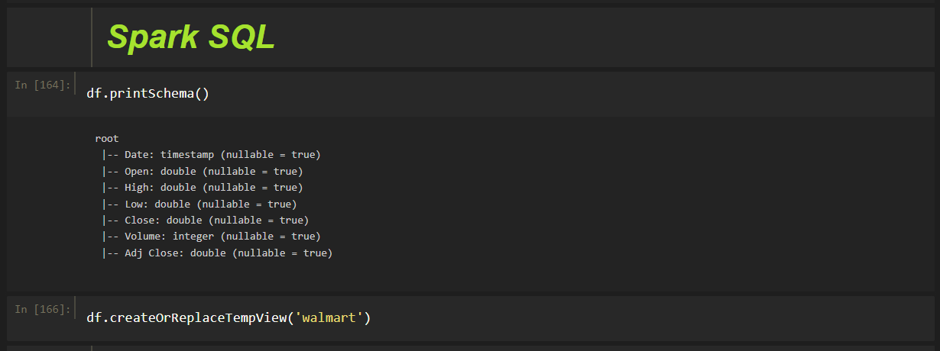
Interactive Analysis using

Slide 18
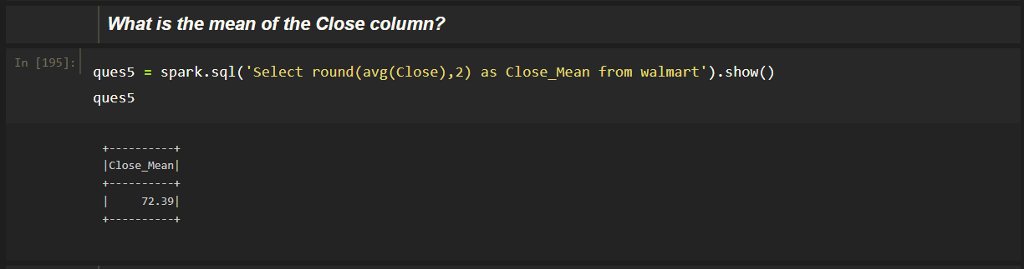
Problem Statement
Question 5: What is the mean of the Close column?

Slide 19
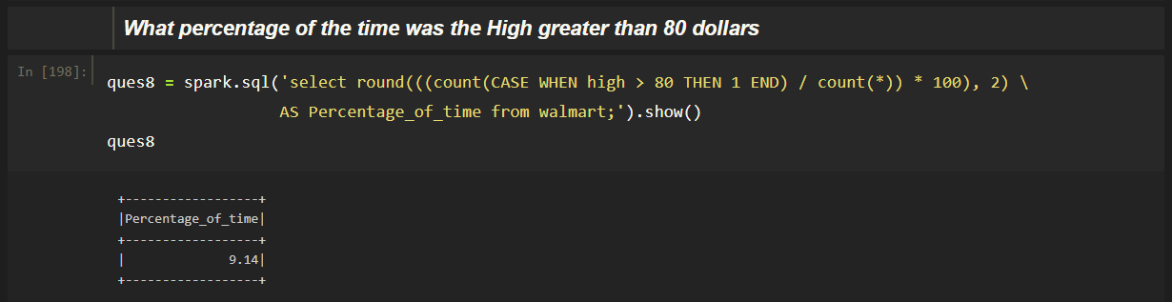
Problem Statement
Question 8: What percentage of the time was the High greater than 80 dollars?

Slide 20
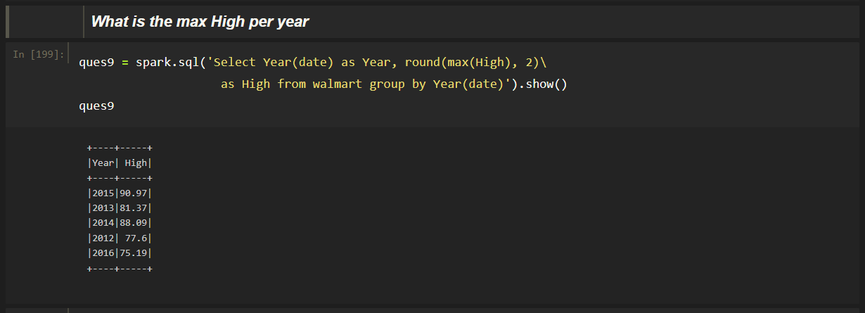
Problem Statement
Question 9: What is the max High per year?

Slide 21
Visualization

Slide 22
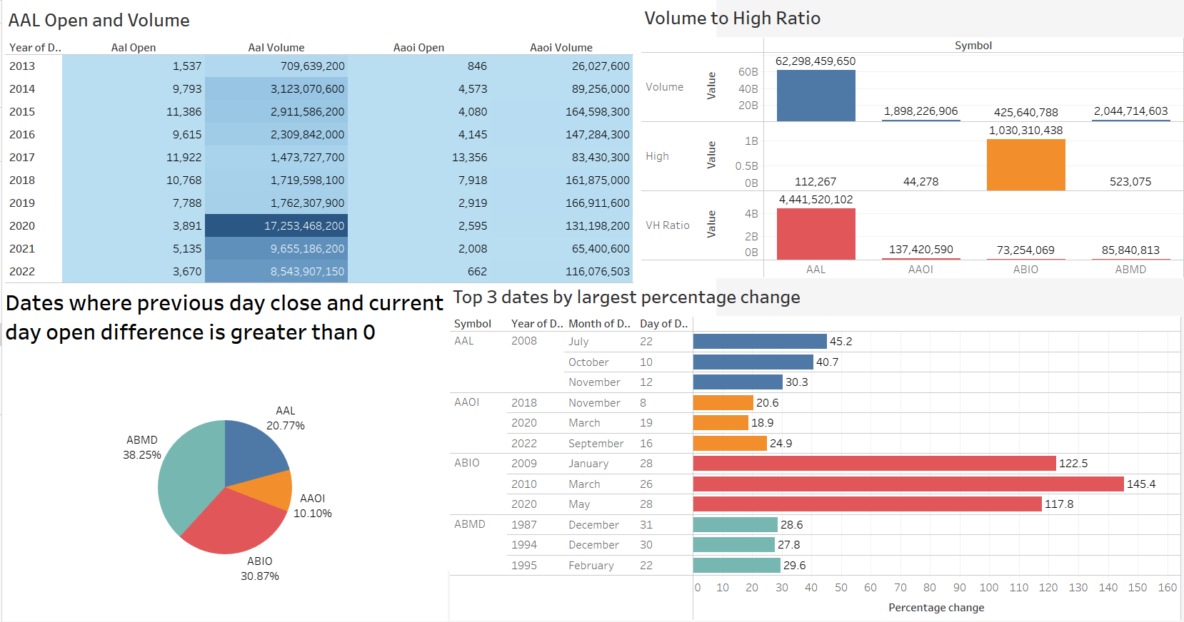

















Dashboard

Slide 23
Insights from Visualizations
We are able to conclude that AAL stock was purchased in huge quantities in the year 2020 – around $17.2 B
The top 3 dates where open to close percentage change is more for ABIO stock compared to other stocks. But even then the difference between the 2nd and 3rd date is around 10 years – which shows that there might be a drop in the stock price during these 10 years.
ABMD kept increasing for around 8 days in 2012 which suggests that the stock was doing well during that period.
The AAL stock has the highest Volume to High ratio as compared to other stocks which is significantly low – This specifies that people have great interest in this particular stock, regardless of the price.
AAL – American Airlines
AAOI – Applied Optoelectrics
ABMD – Abiomed Inc
ABIO - ARCA BioPharma Inc

Slide 24

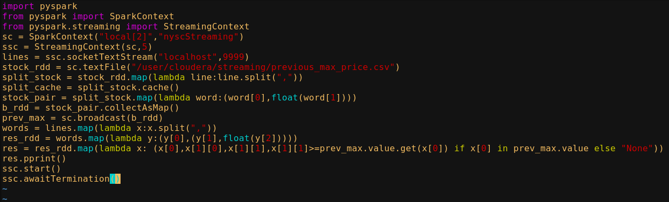
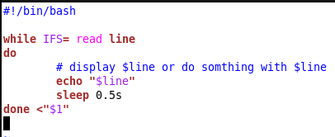
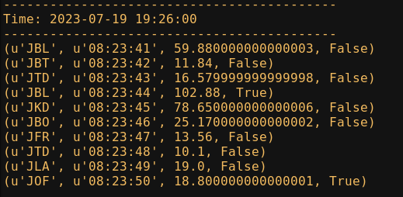
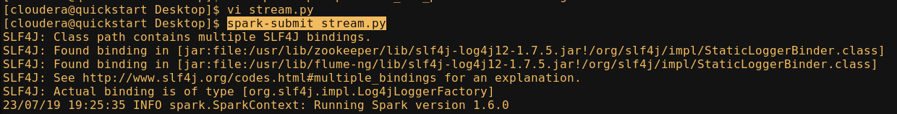
Streaming Analysis using
stock_details_socket.sh – reading line by line from stock_stream_data.csv
stream.py – code file
OUTPUT
Running the job

Slide 25
Thank You

